Slide 1
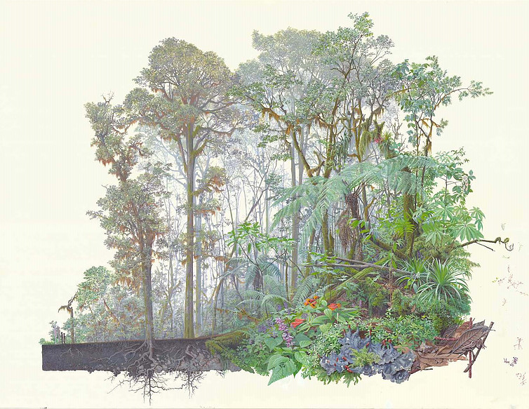
Comparative ethnobiology A multimedia data portal and metadata standards for integrating traditional ecological knowledge across communities
Jonathan D. Amith (jonamith@gmail.com) Gettysburg College)
Society for Ethnobiology, Vancouver, 8 May 2019

Slide 2
DEMCA: A regional portal for comparative ethnobiology
Notes:
Begin the discussion with the idea of a portal as a workspace where stakeholders from a wide range of interested parties can explore ethnobiological material
Scholars interested in MANAGING their own datasets. DEMCA can serve as a research tool for collaborative work.
Communities interested in creating their own resources (access can be controlled to particular types of knowledge)
The general public interested in seeing and hearing native speaker discussion of their immediate natural history environment
Note that the focus of DEMCA is on COMPARATIVE work on linguistic/cultural and functional (plant use) commonalities across societies and cultures

Slide 3
demca.sites.gettysburg.edu
What is ethnobiology
Ethnobiology is considered the documentation and analysis of the nomenclature, classification, and economic and symbolic management and use of flora and fauna in communities (both Indigenous and non-Indigenous).
Comparative ethnobiology involves the analysis of similar (though heretofore non-standardized) data from two or more localized studies. n
1. Why study comparative ethnobiology
Data from distinct, disperse yet genetically related linguistic-cultural communities can shed important light on cultural history: the ecology and location of the homelands of the ancestors of these related communities.
Data (particularly word loans, calques, and shared uses and cultural beliefs) from linguistic-cultural communities that are genetically unrelated can shed important light on patterns of migration and contact in prehistoric times.
Notes:
Premise: Given sensitivity to change, nomenclature, classification, and use of local flora and fauna provides a particularly useful tool for documenting
The ecologies of ancestral homelands : Cognates and reconstructed terms
Patterns of migration and contact: Loans and calques (loan translations)
Goals: This project will develop a standard (compatible with other standards) to mark up this data so that the efforts of researchers will be in a common format.
A portal is needed facilitate discoverability and MOST IMPORTANTLY annotation (annotation because the relations are no always clear-cut)

Slide 4
2. Why attach ethnobiological data to a (Symbiota-based) portal
The present project will build upon Symbiota (which uses the Darwin Core standard) by creating a compatible standard for ethnobiological data and using the extant functionalities of Symbiota as a foundation upon which to construct tools for the somewhat distinct needs of an ethnobiological portal.
3. What are the specific challenges to this project:
Development of standards for ethnobiological data: tags and controlled vocabulary;
Treatment of the data from a sociological and ethnographic perspective (e.g., of errors and conflicts) very different from the treatment of collection/specimen data
Ambiguous interpretation of much primary data (e.g., cognates and calques)
Challenges of creating an “annotation mode” to facilitate not only discussion of perspectives on the data but permanent archiving of these discussions (cf. to changes in species determinations of herbarium specimens).
Goal of creating a virtual space for multidisciplinary and multisited collaboration (e.g., Indigenous villages, taxonomists, linguists/anthropologists)
Notes:
Standards: Even such a simple question such as “What is the vernacular language?” can be challenging. DEMCA, as will be shown, uses Glottocode to identify languages and then Community and Speaker for fine-grained . More difficult standards are those in relationship to orthography. It may be that a researcher or native speaker does not properly understand the vernacular language phonology. Or use different graphemes (<c> or <q> or <k>
Treatment of data variation: Show examples of Melastomataceae from Zongozotla and the difficulties. This is what primary data looks like. What does this tell us about the distribution of knowledge and the solidity of Indigenous nomenclature and categorization?
Cognates and calques are problematic. Cf. ‘stink bugs’. Use the example of the begonia named Melastomataceae
Necessity of an “annotation mode” and “verbatim” vs. “annotated” data
Interactive to promote commentaries and discussion.

Slide 5
Data from distinct, disperse yet genetically related linguistic-cultural communities can shed important light on cultural history: the ecology and location of the homelands of the ancestors of these related communities
Plant and animal terms reconstructed to proto-Uto-Aztecan (Fowler, 1983)
Grass
Coyote
Turkey vulture
Louse
Prickly pear
Squirrel
Hawk
Heron
Pocket gopher
NO HOT DESERT FAUNA
Pine
Screech owl
Agave
Sandhill crane
Fowler considered additional factors to suggest S. California, New Mexico and Sonoran desert as the ancestral homeland.
Yet adumbrating the need for this present project Fowler observed:
“Given the quality and quantity of data presently available, suggestions will continue to outweigh conclusions.”
Notes:
Discuss how reconstruction of terms (*proto-forms) and their referents can suggest the ecosystems inhabited by ancient peoples. E.g., in “pine” reconstructions to the protolanguage spoken by ancestors of languages A, B, C, and D. Then the lands of the ancestors probably included pines. There is always the challenge of semantic shift but the general strategy is to find cognates with similar referentes and create a tree of reconstructions.
Note that this only works with cognates in genetically related languages.

Slide 6
Data from distinct, disperse yet genetically related linguistic-cultural communities can also shed important light on the history of language diversification
Proto-Aztecan (includes Pochutec, Pipil, Nahuatl)
S
O
U
T
H
E RN
MI GRATION
+ scorpion
(kōlō-)
+ Ficus spp.
(āma-)
+ zapote
(tsapo-)
+ tomato
(toma-)
+ avocado
(awaka-)
+ iguana
(k^{w}ets-)
Migration southward into subtropical floristic zones by Proto-Aztec speakers led to development of new lexical terms with no cognates in other Uto-Aztecan languages

Slide 7
Data (particularly word loans, calques, and shared uses and cultural beliefs) from linguistic-cultural communities that are genetically unrelated can shed important light on patterns of migration and contact in prehistoric times.
Word loans : Words are borrowed from one language to another: As Nahuatl speakers moved into Puebla a significant number of terms were borrowed from Totonac into Nahuatl only one has been documented in the opposite direction
cockroach: xopepe [Nahuatl] < xumpé:pi’ [Totonac]
various aroids: chāpis [Nahuatl] < chāpís[u] [Totonac]
Anredera sp.: omisāl [Nahuatl] > ōmisalh [Totonac]
Calques (loan translations) : The meaning of a word in one language is translated into another:
Solanum lanceolatum Cav.
Totonac: xlhixtokg cha:t (‘woman’s walking cane’)
Nahuatl: itōpīl lamatsīn (‘old woman’s walking cane’)
Boa constrictor = ‘deer snake’
Nahuatl: masākowat
Yucatec Maya: chij' kan
Cultural beliefs : Distinct cultures share specific beliefs about or uses of local plants and animals that could not be the result of independent invention
Camel spiders and whip scorpions:
pīnāwistli (‘shame’) [Nahuatl] < > ti¹ka’³an⁴ (‘animal-shame’) [Mixtec].
Shared meaning evidences the association of these arachnids with shame in each culture.
Velvet ants are considered omens in various Mesoamerican cultures

Slide 8
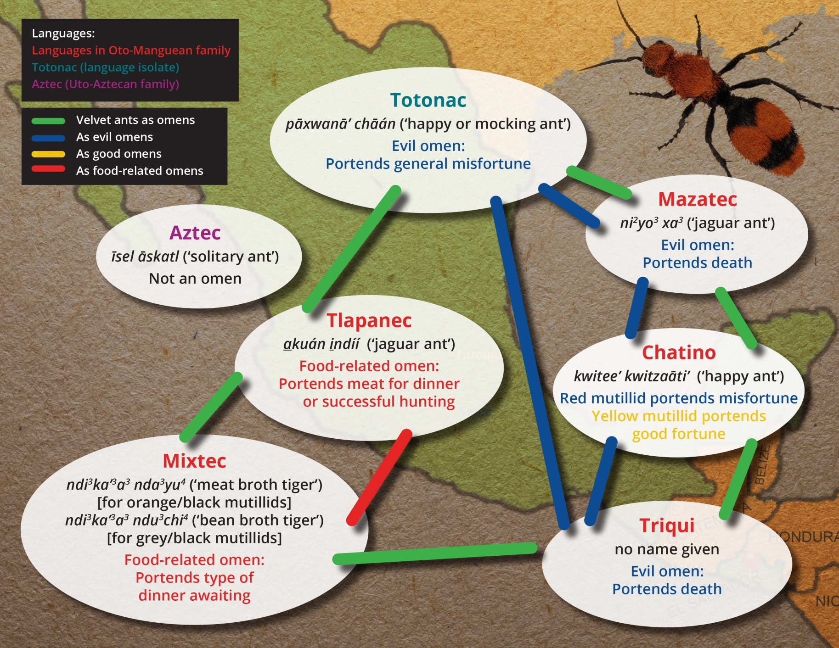
Velvet ant nomenclature and beliefs in Mesoamerica
Jonathan D. Amith, Gettysburg College | jonamith@gmail.com
Notes:
Velvet ants are omens in Otomanguean languages/cultures thought the type of omen is divided into
Misfortune
Food related (what’s for dinner)
In Tlapanec, Mazatec and Mixtec there name includes the word for ‘tiger’ not unusual given the prominent coloring of Dasymutilla.
In Mixtec the name references the type of food that will be awaiting in the evening.
Note that Totonac has a belief in velvet ants as omens. The name is not a calque, ‘happy or mocking ant’.
Aztec has no belief but rather the name refers to the solitary nature of the wingless diurnal females.
How can this information be encoded to facilitate discovery. How can we allow annotation and new data entries.

Slide 9
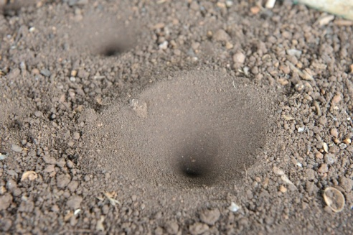
Beliefs about ant lion larva in Mesoamerica
Totonac: swilhīnkuyāt (meaning uncertain)
When a thorn, splinter, piece of bone or any other small hard sharp object penetrates
the soul of ones foot and after several days has still not been expelled, the affected person catches an ant lion larva and places the swilhi:nkuya:t on top of his or her foot right opposite where the object is stuck. The animal causes the body to expel the foreign object.
The same animal is used to extract molars with cavities. The larva is placed alive in or on the bad tooth and it is said that it causes it to fall out.
Náhuat from Cuetzalan: tālpīpītsani (lit. 'earth-blower').
In the village of Tacuapan, Sierra Nororiental de Puebla, this insect is used to cure a condition of swollen big toes. The Mymeleon is caught and crushed along with a particular type of spider of a bright coffee color. The resulting ointment is spread over the affected toe with thin skin of an onion. This causes the toe to burst open, releasing the pus inside. In San Miguel Tzinacapan, the animal is used like in Zongozotla but, as in Tacuapan, with a spider. In Tzinacapan the ant lion larva is taken and along with a house spider crushed and placed on the point that the object has entered the soul of the foot or a toe. This causes the object to be expelled.
Yoloxóchitl Mixtec: ndi³ki⁴bi⁴ (lit., 'animal-entrar'?)
In Yoloxóchitl there exists the belief that a petition to the ant lion larva is offered when ones child has gotten dirt or dust in his or her eye. The parent of the child so affect calls out to the ndi³ki⁴bi⁴ (it is not necessary to be holding one in one's hand): " Ndi³ki⁴bi⁴, ndi³ki⁴bi⁴ remove the dirt from the eye of my child and if you do I will give you some old cloth for your children's diapers'.

Slide 10
Indigenous nomenclature: The challenge of standards and nesting relations
Glottocode and ISO 639-3 equivalent
DwC <vernacularName/> tag: Deficiencies for humanities and social science research
Darwin Core suffers from non-standardized specification as to the vernacular name language;
Symbiota cannot link vernacular names or uses on a range of commonalities
cognates, loans, calques for names; shared use /beliefs
Symbiota functionalities (e.g., .mapping cannot be applied to <vernacularName/> tags and isoglosses
Suggested solutions for vernacular name:
Use standardized code & controlled content (e.g., <subjectLanguage>glottoclode#</subjectLanguage>
Connect to established hierarchy (glottocode) that permits searches at different levels of inclusion.
Create an annotation functionality on <vernacularName/> that will facilitate
+ comments on name (by depositor and users)
+ links of name to other names that are considered cognates, calques or having shared beliefs or uses
Notes:
Offer a clear discussion of the problem of uncontrolled designation of the language of the vernacular name. The taxonomic hierarchy of glottocode/glottolog

Slide 11
Cognates: Words descending from a common *proto-form (‘ancestor’)
Considerations in cognate sets
Random diachronic semantic shift:
tlāpātl Datura spp. (some Balsas Valley Nahuatl communities)
tāpāt Brunellia mexicana (Sierra Nororiental de Puebla Nahuat)
tekolōtl various species of owls (‘tecolote’ in Spanish)
tekolōt louse (Sierra Nororiental de Puebla Nahuat)
2. Non-random diachronic semantic shift:
kowyestli (lit. ‘tree-blood’) Jatropha elbae (Balsas Valley Nahuatl communities)
eskowit (lit., ‘blood-tree’) Croton draco (Sierra Nororiental de Puebla Nahuat communities)
3. Isolated shifts to community-specific nomenclature
sakapal/sakapahli/sakapalli Cuscuta spp.
> itson wetskistli (lit., ‘hair of a carnival performer’) San Miguel Tecuiciapan, Balsas River valley
Analysis of patterned variation across genetically related languages at different levels of historical relations
Stability of cognates may reflect
a. Relative degree of human management
b. Morphological structure of the bioterm (i.e., monomorphemic, compound)
c. Relative commonality of the referent

Slide 12
Linking cognates across genetically related languages
Patterned linguistic variation among distinct genetically related languages will be reflected in the nomenclature of flora and fauna:
Squash ayohtli ayohtle ayoh (Nahuatl)
Avocado awakatl awakat pāwa (Nahuatl)
Smilax sp. (edible) i³tun⁴ ti¹su⁴ma⁴ yuva so’ma (Mixtec)
Senna spp. i³ta² tiu¹³ma² tuita timi (Mixtec) ti1mi3i4
ayohtli
ayohtle
ayoh
Author: J. Amith
Ayohtle manifests front vowel lowering, characteristic of San Juan Tetelcingo, Guerrero. Ayoh manifests the complete loss of the absolutive suffix –ti (Sierra Nororiental de Puebla; the absolutive is -tli in other Nahuatl languages) + ADD COMMENT
i³tun⁴ tiu¹³ma²
tuita
timi
Author: J. Amith
I³ta² tiu¹³ma² means ‘carpenter bee flower’, undoubtedly a reference to the buzz pollination of Senna by bees of the genus Xylocopa. Tuita timi, from a different Mixtec language, has not been glossed but in many Mixtec languages timi is a large, aggressive solitary bee (e.g., t¹mi³i⁴ in the language that calls Senna i³ta² tiu¹³ma². + ADD COMMENT

Slide 13
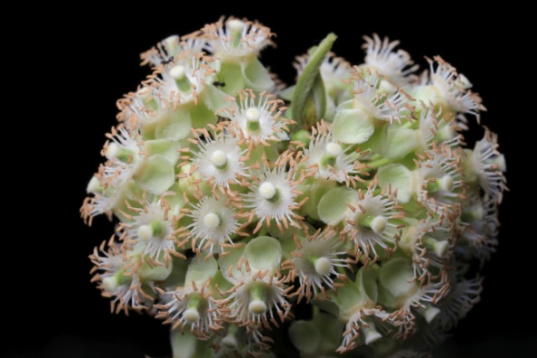
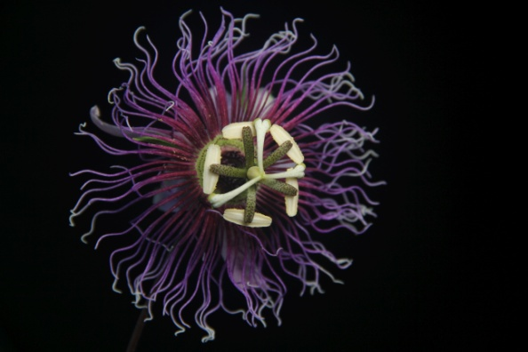
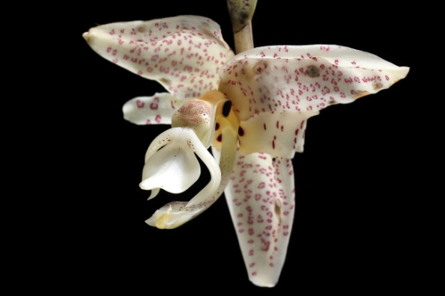
DNA barcodes, photographic records and “rapid response” ethnobiological research: the utility of Symbiota for matching DNA sequences and photos to ethnographic data and species identification
Traditionally ethnobiological research involves field collections (for plants of fertile specimens) associated with ethnographic data and then the distribution of material to taxonomic experts
Yet in a restricted floristic environment it is possible to determine to species a significant amount of material through: (1) high quality images of flowering plants taken by native speakers trained in digital photography (approx. 60%) ; (2) tissue samples sequenced (rbcL, matK, ITS, trnH-psbA) and matched to a DNA barcode reference library
Symbiota will be enhanced to facilitate “virtual” collaboration among native speaker communities, taxonomists (who will receive digital images in the families of their expertise), and linguists/anthropologists
Symbiota will be enhanced to allow DNA sequences to be associated directly to ethnobiological data

Slide 14
Summary
Comparative ethnobiological research can illuminate patterns of contact among unrelated linguistic and cultural groups
Comparative ethnobiological research can provide evidence of the ecology of the ancestral homeland of linguistic and cultural groups descended from a common ancestral (proto) language
Ethnobiological data is distinct from biological (collection/identification) data in that with the former both primary data and summary data are important. Primary data would be the in-field ethnographic data (including “errors”) obtained at the collection event; summary data would be a commentary on or analysis of the primary data.
At present there is no standard to facilitate the archiving, annotation, and retrieval of comparative biosemantic data
This standard must be created and made compatible with other standards (Darwin Core, IMDI, OLAC). Glottocode has been offered as an example of a standard to tag Indigenous vernacular languages
Mechanisms must be developed for discovery and annotation of biosemantic “nomenclature of interest” such as cognates, loans, calques, and shared cultural beliefs
Symbiota software (for databasing biological specimens) offers a solid foundation not only to manage ethnobiological research but to facilitate, through an online portal, multidisciplinary collaboration among native communities, biologists, and social scientists.

