Slide 1
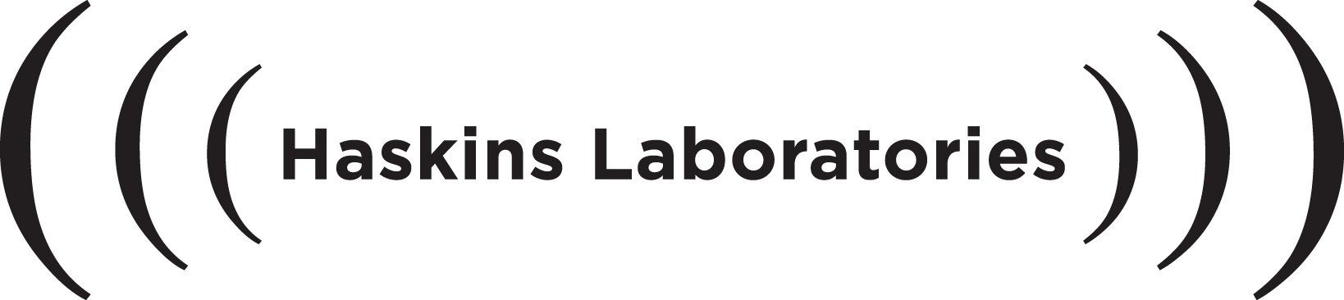
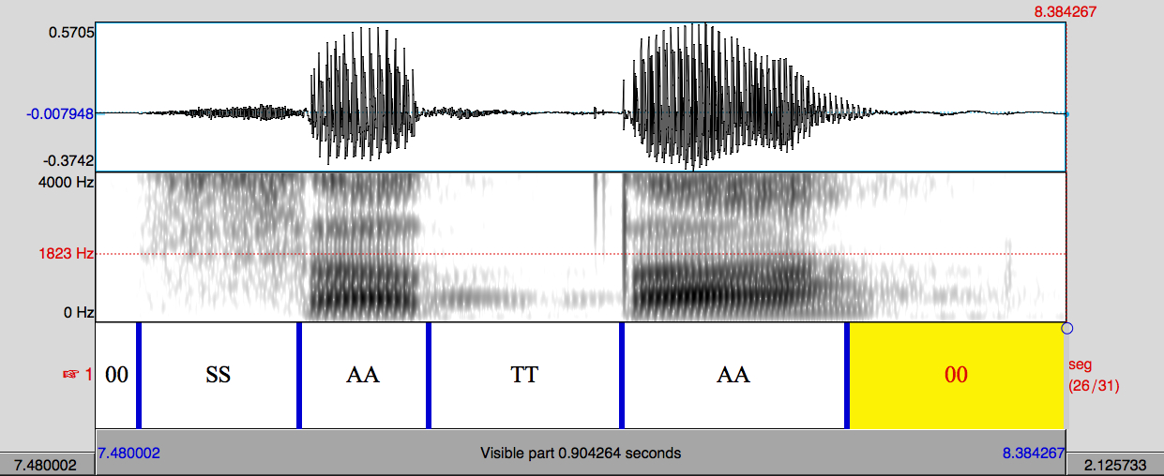
Extracting accurate acoustic phonetic data from inaccurate alignment
Christian DiCanio¹, Hosung Nam¹, D. H. Whalen^{1,2}, Jonathan Amith³, and Rey Castillo García⁴
1. Haskins Laboratories, 2. City University of New York 3. Gettysburg College
4. Secretaria de Educación Pública (SEP), Guerrero, Mexico.
Funded by
I. Phonetics & endangered languages
Endangered language documentation projects involve 30⁺ hours of speech.
Vitality of corpora is dependent on accessibility to researchers and the community.
Extracting phonetic data from these corpora is arduous. Is there an easier way to segment the data?
How much data is enough?
VI. Results: how accurate is FA with
Yoloxóchitl Mixtec data?
III. Yoloxóchitl Mixtec
Endangered Mixtec variant spoken in Guerrero, Mexico.
Large-scale documentation project with 100⁺ hours of transcribed texts; phonetic/phonological studies (Castillo-García 2007, DiCanio et al. 2012).
Corpus = 261 words in isolation x 6 reps x 10 speakers = 15,660 tokens (monosyllables & disyllables).
Better agreement between hand-labelling and hm-Align than between hand-labelling and P2FA.
Agreement is typically 70-90% at 20 ms or better for other FA models (Malfrère et al. 2003). Does this matter?
II. Forced alignment (FA)
Automatically segments speech.
Usually language-specific and trained on large corpus, it requires a lexicon of words, a transcription of the speech signal, and the speech signal itself.
The training data is used to build HMMs for the acoustic signature of each phone. The FA system then uses its internal model to predict where boundaries between phones occur.
VII. Results: how accurate are the
extracted acoustic measures?
IV. Phonological system
Small consonant inventory but large tonal inventory. 4 levels or 5 contours possible on a single mora.
Open, simple syllables. Words are maximally trimoraic (CVCVCV, CVCVV) and minimally bimoraic (CVCV, CVV).
Input: sound file, transcription /sata/, and “lexicon” containing coding of transcription, e.g. /sata/ = SSAATTAA.
V. Forced alignment
Compared accuracy of FA to hand-labelled data using P2FA and hm-Align
P2FA (Yuan & Liberman 2008, 2009) uses GMM-based monophone-HMMs trained using the SCOTUS corpus; phonemic.
hm-Align (Bunnell et al. 2005) uses a set of discrete monophone HMMs trained on data from the TIMIT corpus (Garofolo et al. 1993); allophonic.
VIII. Results: how much data is needed to approximate the mean?
With alignment done, Praat scripts can be used to extract acoustic data.

